Slide 1
University Anti-slavery Program Overview 2023

Slide 2
About this Overview
This pack provides an overview of the University Anti-slavery Program; its objectives, workstreams and activities delivered during calendar year 2023.
Please direct any questions you may have to the University Anti-slavery Program Manager. Holly Kissner
hkissner@hes.edu.au
© Australasian University Procurement Network

Slide 3
Anti-slavery Program Membership
The Australasian Universities Procurement Network (AUPN) currently has 38 Australian and 3 New Zealand member institutions working together to improve excellence in procurement practice and in the skills of procurement professionals in the higher education sector.
In 2023 we welcomed two new members, RMIT & UniSuper.

Slide 4
University Anti-Slavery Program
Objectives & Drivers
To support members to improve supply chain human rights transparency, reduce individual university costs and resources, collaborate on risks and issues for greater impact, and contribute to reporting requirements.
Key Benefits
Compliance
Including The Modern Slavery Act 2018 (Cth) & (NSW) and New Zealand modern slavery legislative reporting requirements. Universities wish to demonstrate leadership on this important issue.
Efficiency
Working together will minimise the duplication of activities and associated costs across individual universities, including risk assessment, implementation of systems and remediation.
Effectiveness
Leveraging our aggregated buying power should improve our capacity to identify and action any modern slavery risks and drive more effective changes through our supply chains.
Capability
AUPN members are an engaged group of procurement professionals within publicly spirited organisations, operating in a uniquely collaborative sector.
Cooperation
By accessing our academics across Australian and international universities and engaging with civil society organisations to build capacity and stay abreast of the latest trends and emerging issues to be industry leaders.

Slide 5
University Anti-slavery Working Group
Managing the objectives & activities in 2023
Members throughout 2023 | Institute | Modern Slavery Working Group Role
Rhiannon Jones | Swinburne University of Technology | Chair
Holly Kissner | High Education Services | Program Manager and Lead for FRDM and Third-Party Support Programs
Daria Toschi | Griffith University | Sector Risk Identification and Remediation Lead
David Paterson | Flinders University | Capability Uplift Lead
Daren Murphy | University of South Australia | Engagement Co-lead
Susan-LaVelle Butler | Australian National University | Tender & Alert Process Co-lead
Megha Samtani | University of Queensland | Tender & Alert Process Co-lead
Lauren Beare | The University of Adelaide | Data Quality Lead
Christine Denoon | University of Canberra | Engagement Co-lead
Caty Harrall / Erin Elmes | The University of Melbourne | Contributors
Nicole D’souza / Jonathan Gold | The University of Sydney | Contributors
Emma Hale / Tamarin King/ Adam Baxter | University of Newcastle | Contributors
New members always welcome! Register your interest with Holly Kissner - hkissner@hes.edu.au

Slide 6
Academic Advisory Board (AAB)
2023 Meetings and insights
The Academic Advisory Board was established in July 2020. One meeting was conducted in 2023 with the next meeting scheduled in February 2024.
The Board’s aim is to enrich the AUPN sector approach through leveraging academic experience and learnings and embedding best practice recommendations and insights into program activities.
Board members were provided updates on the University Anti-slavery program and the discussion were focused on specific themes/topics of interest to the sector, in 2023, international student risk was a key focus.
Board Member | University
Vikram Bhakoo | University of Melbourne
Marie Segrave | Monash University
Ingrid Landau | Monash University
Dayna Simpson | Monash University
Martijn Boersma | University of Notre Dame
Mark Strachan | Swinburne University
Marinella Marmo | Flinders University
Kate van Doore | Griffith University
Katherine Christ | University of South Australia
Nerida Chazal | University of South Australia
Meeting 13 September 2023
University Anti-slavery Program & technology solution update
Welcome to new AAB members
Academic insight into key areas of university risk
International student risk: prioritisation of action should be guided by the UNGP according to risk to people. International students have been identified as a vulnerable group that are within universities circle of influence. It was agreed this should be a key area of focus for the sector in 2024/25.

Slide 7
2023 Program Pillars
Key areas of focus for the program in 2023
Risk Software
Training & training materials
Data uploads & quality
Capability Uplift
Academic Advisory Board
Engagement
Resources for stakeholder engagement
Operational processes
University Modern Slavery Forums
Expert insights
External collaborations
Issues/Risks Collaboration
3rd Party Program Support
Supplier questionnaires & analysis
Cleaning Accountability Framework (CAF)
Electronics Watch review
Presentations to university stakeholder groups
Media alert action collaboration
Subgroups to act on category risks & issues
University support
Issue remediation
Sector risk insights
Australian Red Cross – international student risk
Others

Slide 8
Program key achievements in 2023
FY2022 data upload to FRDM Tool
FRDM Participation Agreements signed – 35 Uni’s (3 more waiting to sign)
University Media Alert Process approved & implemented
AUPN LinkedIn activity
Engagement with community and industry
University Anti-slavery Program Manager commences
New Academic Advisory Board & Working Group members appointment
Academic Advisory Board meeting
Data & Technology
Framework
Engage & Comms
Governance
Third Party
Engagement
Australian Red Cross International Student Worker Exploitation Hub project initiated
Monthly University Modern Slavery Forum with expert guest speakers
Modern Slavery software review and recommendation
Training & Capacity
ArcBlue engaged to provide 2023 modern slavery risk dashboards
Cleaning Accountability Framework (CAF)
Pilot program & data collection opportunity*
Monthly reporting on program results to AUPN Executive
FRDM software training sessions/ recordings / user guides
Electronics Watch pilot (still scoping final details)
Expert legislative guidance guest speakers at forum presentations
- NSW Anti-slavery Commissioner
- Monash Centre for Financial Studies
Contributed modern slavery data requirements into the University Procurement Analytics Service project
AUPN Portal set up with internal and external MS training resources
Monthly Anti-slavery Working Group meetings
The Faculty Presentation
London University Purchasing Consortium
Australian Red Cross
Electronics Watch
The Mekong Club
Be Slavery Free
Australian Catholic Anti-slavery Network
TelcoTogether
SA Modern Slavery Network
*Only reference CAF in your statement if your university is engaging with them directly.
Monthly project update, documents, and meeting minutes available in the AUPN Portal
https://arcblueportal.com/category-communities-of-practice/modern-slavery-docs-and-templates/

Slide 9
Engagement and Communications
Promoting the University Anti-slavery Program and engaging outside the network
Month | Presentations, meetings & Seminars outside the AUPN | Details
Feb | - | -
March | Presentation to TelcoTogether | Presentation on University Anti-slavery program, focusing on FRDM key learnings/ insights, as both sector collaborations use FRDM as their modern slavery risk software
April | Presentation to Australian Catholic Anti-slavery Network | Presentation on University Anti-slavery program, sharing learnings / insights
May | - | -
June | Modern Slavery Conference | Attorney General’s Department held a 3 day conference in Melbourne. Various members of the program attended and represented the University Anti-slavery program.
July | Presentation to the London Universities Purchasing Consortium | Presentation on University Anti-slavery program, sharing learnings / insights
Aug | Cleaning Accountability Framework | CAF presented universities with an opportunity to provide data to assist with university pricing schedule
Sept | Australian Red Cross | Stakeholder consultation on developing an online ‘International Student Work Rights Hub’ to help prevent and respond to forced labour in Australia specifically for international students
Oct | NSW Anti-slavery Commissioner | Presented at the monthly forum and was provided with an update of the sector level initiatives.
Nov | The Mekong Club & Be Slavery Free | Presentation on the University Anti-slavery program, focusing on future collaboration opportunities & human trafficking
Dec | Macquarie Business School | Participated in an interview with a Macquarie University PHD student providing feedback for a study that is examining how entities are impacted by the Commonwealth Modern Slavery Act 2018 and to provide business entities with guidance on good reporting and business practice compliance.

Slide 10
Capability Uplift
Monthly University Anti-slavery Forum Expert Guest Speakers
Month | Guest | Presentation Details | Attendance
Feb | - | -
March | Cleaning Accountability Framework – Dr Jasper Goss Annual University CPO Conference – Ramilla Chanisheff | - The limits of desk-top auditing, the kinds of issues that CAF is uncovering in the cleaning sector and how membership contributes towards Modern Slavery Reporting. - Why Uyghur Forced Labour Matters for Australians | 35 participants 70 participants
April | Electronics Watch – Julie Petticrew | How Electronics Watch can help universities identify and reduce the risk of Modern Slavery in your supply chains and assist with your statement planning. | 38 participants
May | - | -
June | University of New South Wales – Paul Serov | Effective strategies to access resourcing and engage leadership on modern slavery. | 38 participants
July | University of Sydney – Clare Bartram Anti-slavery Australia – Jennifer Burn | University of Sydney’s Approach to Addressing International Student Risk How to Take Action on Identified University Modern Slavery Risks | 59 participants
Aug | Australian Catholic Anti-slavery Network – Jenny Stanger | Strategies to Operationalise Anti-slavery Processes into your University Supply Chain & Operations | 68 participants
Sept | No meeting due to school holiday conflicts | -
Oct | The Mekong Club – Matt Friedman NSW Anti-slavery Commissioner – Dr James Cockayne | The emergence of human trafficking scam trades and how they can affect universities. Legislative updates and key areas of focus for universities | 68 participants 59 participants
Nov | Monash Centre for Financial Studies – Dr Nga Pham | Overview of previous Modern Slavery statement’s disclosure quality framework along with some practical examples of how universities can improve their criterion responses for 2023 reporting | 55 participants
Dec | No meeting | -

Slide 11
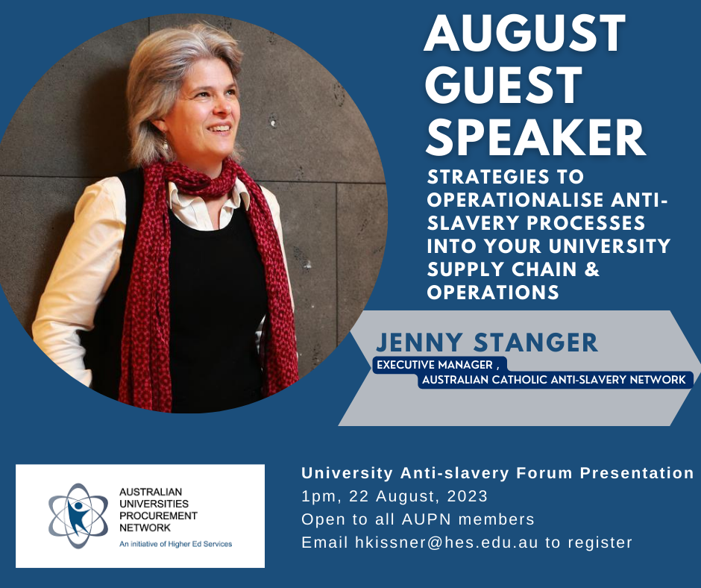
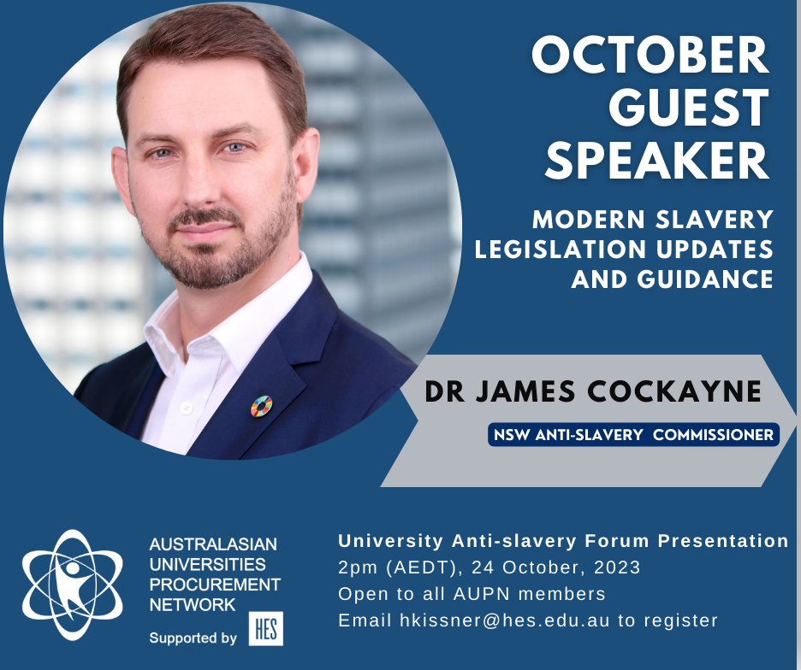
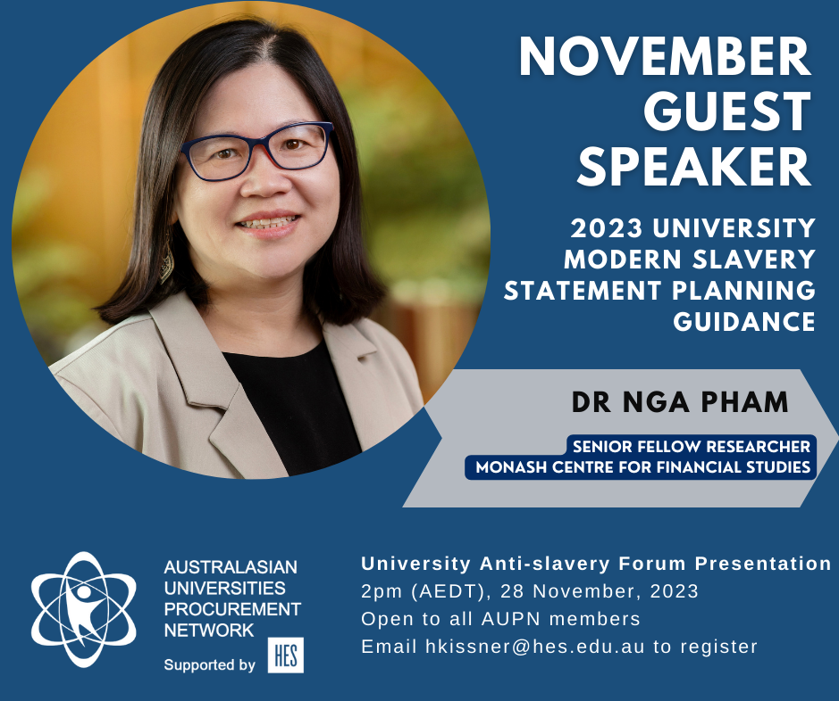
2023 Program Highlights
Solid momentum with a focus on awareness and capability uplift
Monthly forums with expert guest speakers:
50+ attendees across 40 universities each session
Range of topics covered (see previous slide)
Media Alert response process established:
Media Alerts – summarised at each Forum
High risk/high influence alerts – due diligence & other action
Cleaning Accountability Framework – pilot progress
Access to Modern Slavery literature and training tools (available through AUPN portal)
ArcBlue Modern Slavery Risk Dashboards for 2023 data
Addressing International Student Risk with Australian Red Cross and ACRATH

Slide 12
Program Challenges
Barriers to progress requires persistence and commitment
Our sector technology platform – extracting value and fulfilling expectations. Slowed down risk analysis and supplier engagement
Aligning actions & approach – many similarities but ~40 individual entities working at different paces & with different risk appetites
Maintaining momentum - onboarding new staff & keeping working groups moving
Limited capacity – volunteer dependent & most universities don’t have dedicated anti-slavery resources
3rd party programs – set up to support individual businesses, not a sector approach
Technology review and refresh
Deeper risk
& issue collaboration
More engagement with 3rd party collaborations
Capability uplift in light of legislation changes
Exciting Opportunities in 2024

Slide 13
Media Alert Process
University Sector Due Diligence Approach
Media alert working group established in May 2023 to:
Increase awareness and education within the sector so procurement are aware of risks and effects when tendering.
Influence suppliers to take action where appropriate. Use combined leverage to influence supply chain to remediate any identified issues at the source.
All alerts are registered in the AUPN portal for universities to review at any time and discussed at the monthly forum. A due diligence process is undertaken collectively for any shared suppliers that have been identified requiring action.

Slide 14
International Student Risk Project
Multi-stakeholder project to address international student worker exploitation risk
International students have been identified as a high risk group for worker exploitation in Australia. University Anti-slavery program members are working with Australian Red Cross (ARC) and ACRATH to develop fit for purpose tools to:
educate international students on legal working conditions in Australia
educate student facing staff on signs of exploitation
provide access to grievance mechanisms and remediation pathways
Stage 1 – Establishment Now – Dec 2023 | Agree proposal and high-level objectives Establish a steering committee to oversee the project (including terms of reference, desired outcomes, ways of working, impact measurement, timeframe, define front line responders in university setting) Establish working groups for front line responders and students
Stage 2 – Materials review Jan 2024 – April 2024 | Identification of issues/challenges unique to international students Identification of resources available from different institutions Review materials that are available Will materials be meaningful for international students / how could they be adapted to make them more accessible? What specific materials will be helpful and do they need to be adapted? Are other materials required? Review decision trees
Stage 3 – Develop materials May 2024 – Oct 2024 | Update and co-develop materials with working groups
Stage 4 – Review of materials Nov 2024 – March 2025 | Review materials developed Develop and review dissemination strategies Define impact measures
Stage 5 – Launch and dissemination April 2025 | Launch Social media strategy Training and dissemination program
Meeting 18 September 2023 (21 attendees - 13 universities, ARC, ACRATH)
Introductory meeting to gauge interest
Stakeholder introductions
Discussed current tools available
Gathered feedback on what universities think is the biggest issue / barriers
Meeting 23 October 2023 (18 attendees – 12 universities, ARC, ACARTH)
Demonstration of current ARC work right hub tool
Proposal to look at adapting that tool for international students
Discussed access to other tools (ACARTH & University of Sydney online educational modules for students and staff)
Next meeting February 2024

Slide 15
Cleaning Accountability Framework
Pilot Program
“Our objective is to end exploitation in property services and improve work standards through education and advocacy” – https://www.cleaningaccountability.org.au/
CAF engaged the AUPN in February 2021 to assist with the development of a certification framework to cover contract cleaning & security at university campuses.
Key components include:
3 Star standard
Compliance framework and assessment methodology
Procurement tools include a CAF pricing schedule
Associated policies, guidance, tools and resources
PILOT – 2023 and 2024, 3 university campuses
CAF was invited on multiple occasions to present to the broader AUPN community
The Modern Slavery Working Group (MSWG) assisted CAF in the creation and dissemination of project information & surveys
The MSWG and Academic Advisory Board members assisted in discussions and engagement between CAF and interested universities
The MSWG worked with CAF to facilitate interest and participation by universities in a pilot program for 2023, of which 3 universities have nominated to participate
CAF is currently working with around 10 universities on the development of a pilot framework for University campuses and have requested data from universities
STEP 1 Baseline Data Collection Anonymised baseline data on level of awareness and understanding of supply chain accountability collected via an online survey insights collected will help framework development
STEP 2 Contract & Tender Information CAF working on-on-one with procurement teams to gather information about contracts & tendering CAF will provide advice on areas whether labour compliance requirements can be integrated
STEP 3 Engage with University Suppliers CAF to engage with University suppliers to introduce the model and answer any questions
STEP 4 Pilot & Framework Development Interested Universities to work with CAF on development of Pilot Project Working group created to consider pilot draft

Slide 16
Cleaning Accountability Framework
Data Collection Request
CAF presented at the August and September University Anti- slavery forums to request engaging with universities to:
1.CAF Base Line Survey
CAF would like to undertake university cleaning contractors and cleaning/security staff surveys, to better understand what level of knowledge contractors and
2.CAF needs pricing/labour data
Per the CAF Pricing Schedule, to adjust its benchmarks for contract pricing for cleaning services in the higher education sector
CAF provided statement wording for participating universities.
NOTE: only participating universities have been given permission to use the CAF wording in their 2023 statement.

